Slide 1
Multi-Augmentation Strategy Learning Experiment Design
Tran Van Nhiem

Slide 2
End_To_End Pipeline Design
Data Preparation & Preprocessing
Augmentation Strategies Pipeline (Self-Supervised)
Building Neural Net Architectures
Self-Supervised Frameworks
Experiment Tracking – Visualization & Others
Evaluation the Result and Benchmark on different Downstream tasks

Slide 3
1. Data Preparation & Preprocessing Pipeline

Slide 4
Preprocessing Data Pipeline
How to prepare loading dataset?
How to use Parallel Mode for reading data ?
How to do pre-processing data for (Images and Masks) ?

Slide 5
Building Prepare Data
Small Dataset
Large Dataset
Subfolder structure dataset

Slide 6
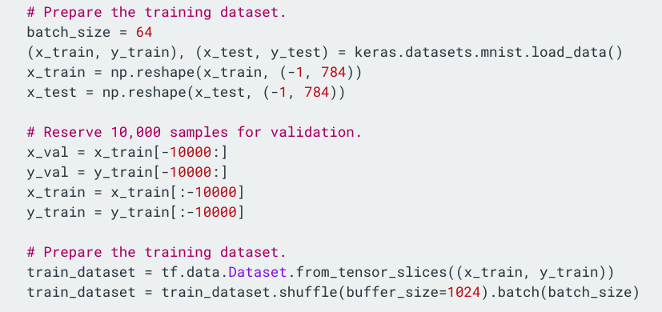
Small Dataset (tf.data.Dataset)
Building Prepare Data
Loading data to Memory

Slide 7
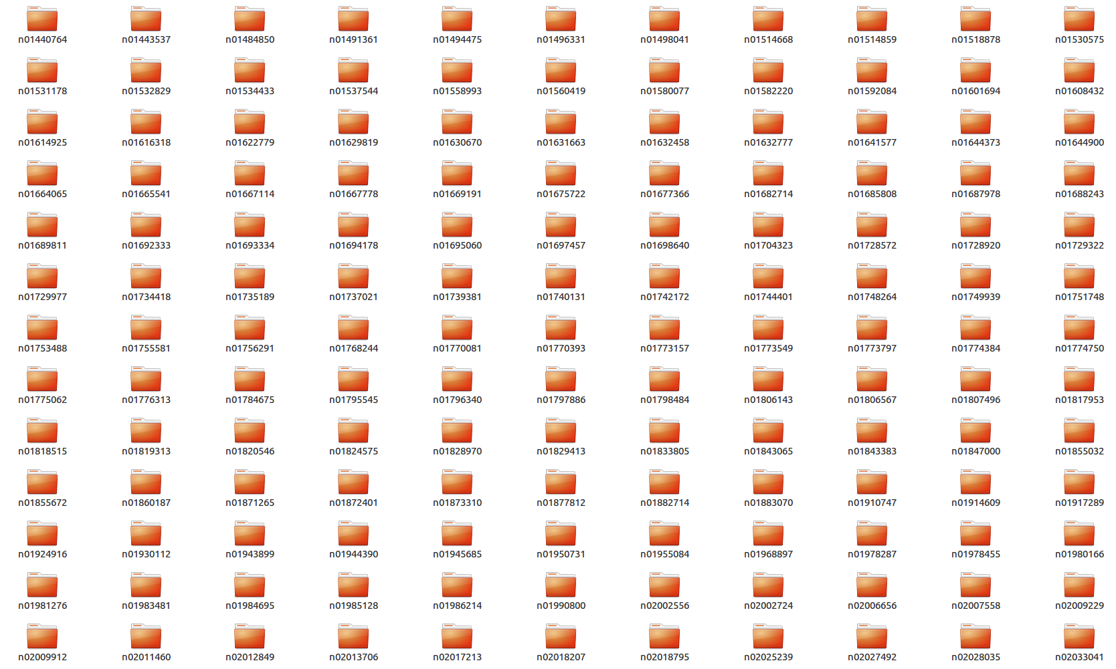
Large Dataset contain in many subfolders
Building Prepare Data
ImageNet Dataset
(Over 1M images )
Large DATASET can’t Hold in the Memory →

Slide 8
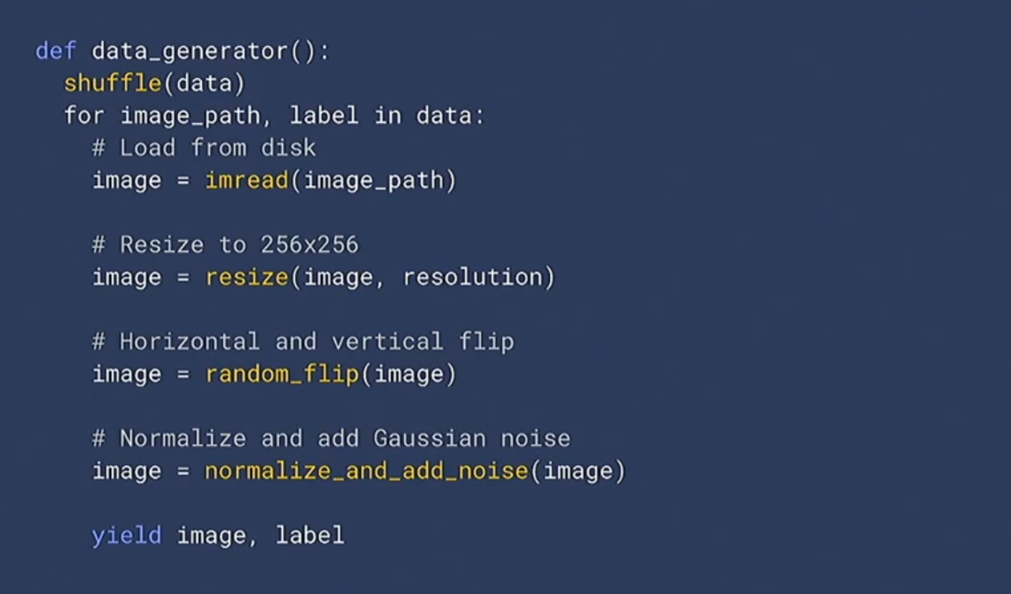
Python Data Generator
Building Prepare Data

Slide 9
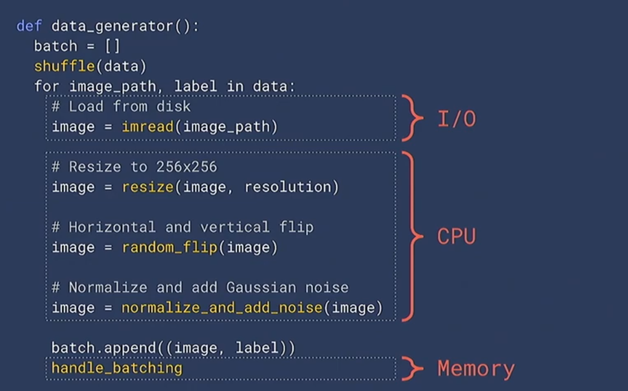
Python Data Generator
Building Prepare Data

Slide 10
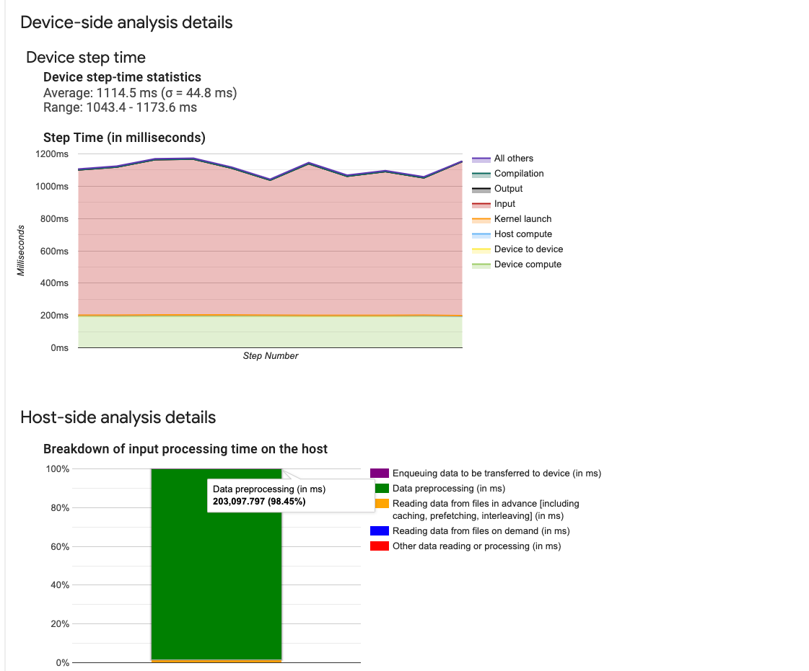
Tensorboard Profile View
Time GPUs Executing Taking Huge a mount of time
Data Processing Taking Huge a mount of time

Slide 11
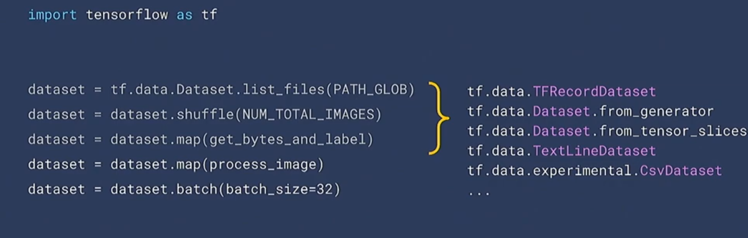
Building Prepare Data
tf.data.Dataset Data Parallelism Input Pipeline

Slide 12
2. Augmentation Strategies Pipeline

Slide 13
Building Augmentation Pipeline
Step 1 Defined Data Augmentation Transformations
Step 3 Implement Augmentation Pipeline with Preparation & Preprocessing Data pipeline.
Step 2 Sequential Apply Augmentation with (Random & Probability Strategy).

Slide 14
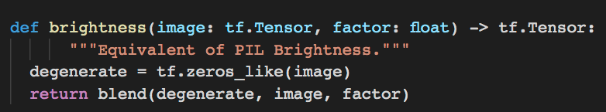
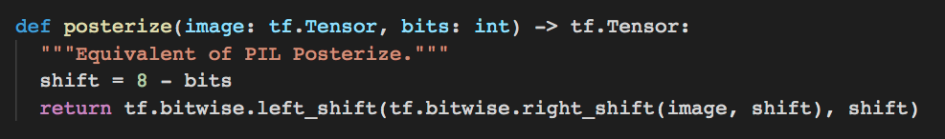
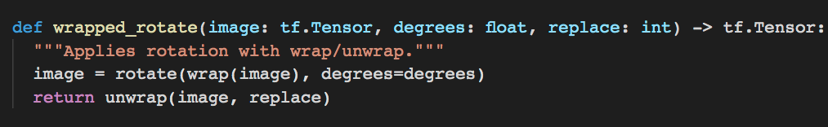
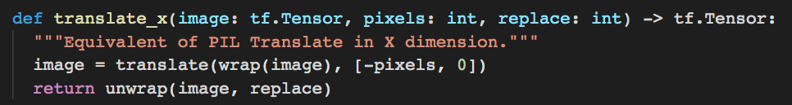
Building Augmentation Pipeline
Step 1 Define Data Augmentation Slected Transformations (Self-Supervised)

Slide 15
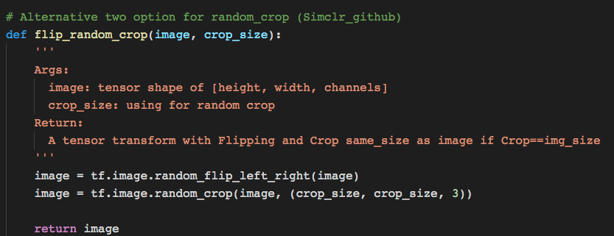
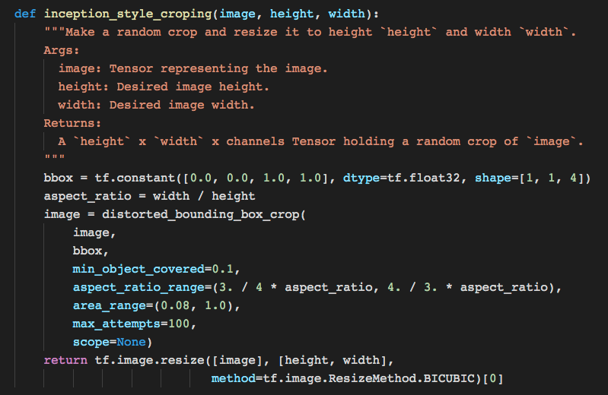
Building Augmentation Pipeline
Step 1 Define Data Augmentation Slected Transformations (Self-Supervised)
Random Cropping Strategy
Inception Style Cropping Strategy

Slide 16
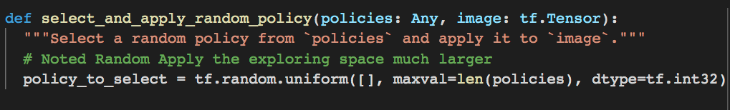
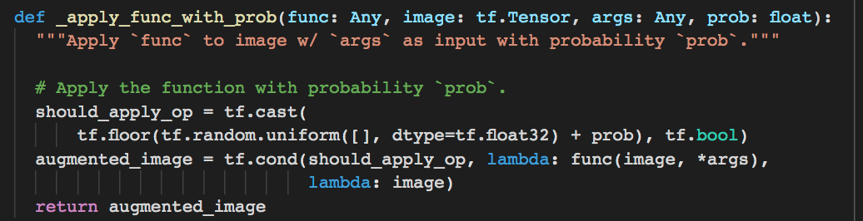
Building Augmentation Pipeline
Step 2 Sequential Apply Augmentation (Random & Probability)

Slide 17
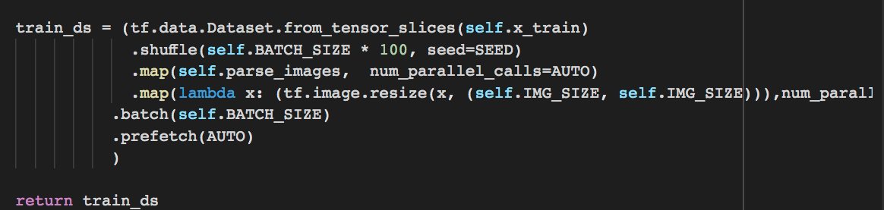
Building Augmentation Pipeline
Step 3 Implement Augmentation Pipeline with Preparation & Preprocessing Data pipeline
Building Python Custome Processing Function (Added to tf.data.Dataset pipeline)

Slide 18
Building Heuristic Augmentation Pipeline

Slide 19
Demonstration Building SimCLR Data Augmentation

Slide 20
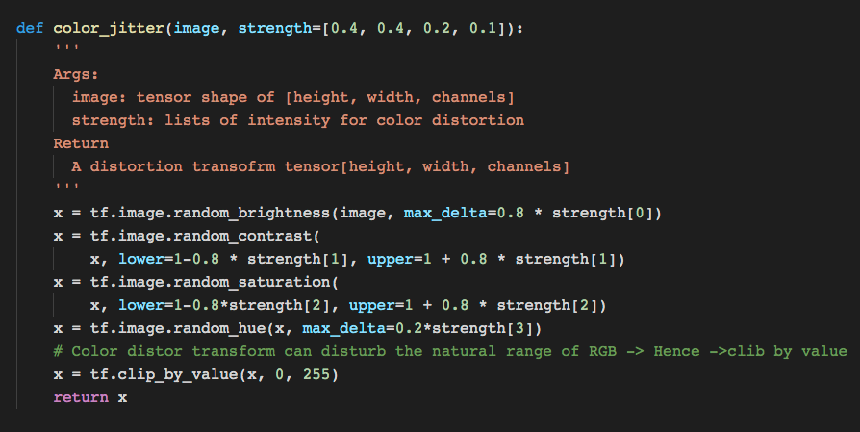
SimCLR Data Augmentation Pipeline

Slide 21
SimCLR Data Augmentation Pipeline
Noted Only For Global Views

Slide 22
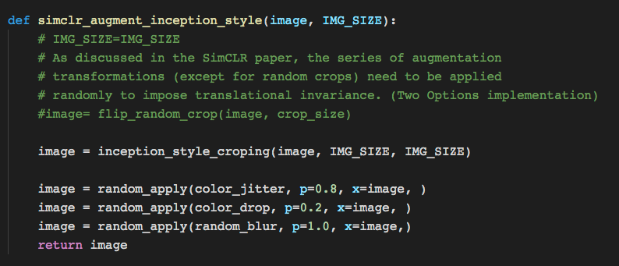
SimCLR Data Augmentation Pipeline

Slide 23
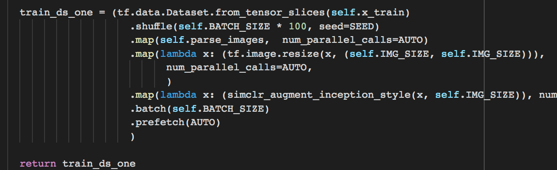
SimCLR Data Augmentation Pipeline

Slide 24
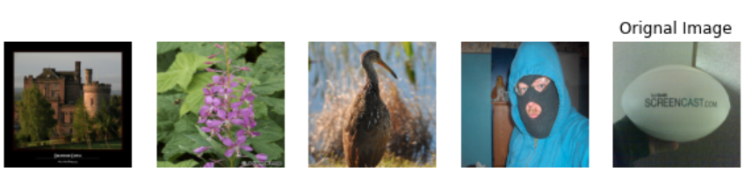
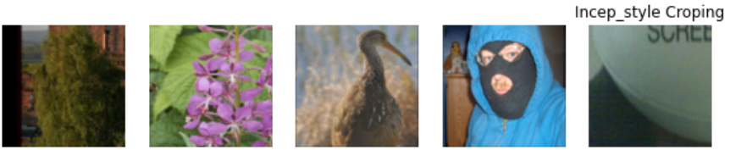
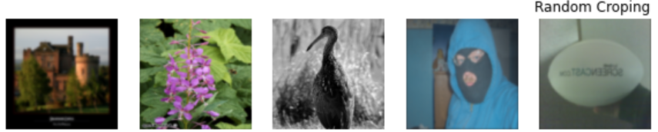
SimCLR Data Augmentation Pipeline

Slide 25
Demonstration Building RandAugment & Auto-Augmentation

Slide 26
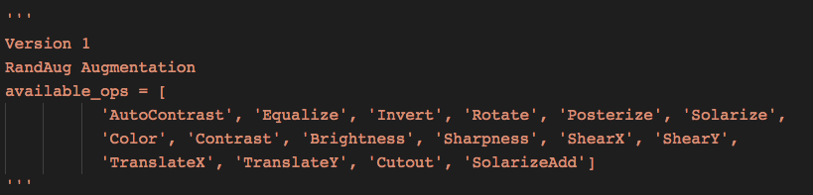
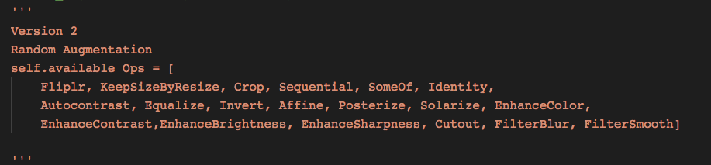
RandAugment -- Augmentation
Version 1 with 16 different Transformations
Version 2 with 22 different Transformations

Slide 27
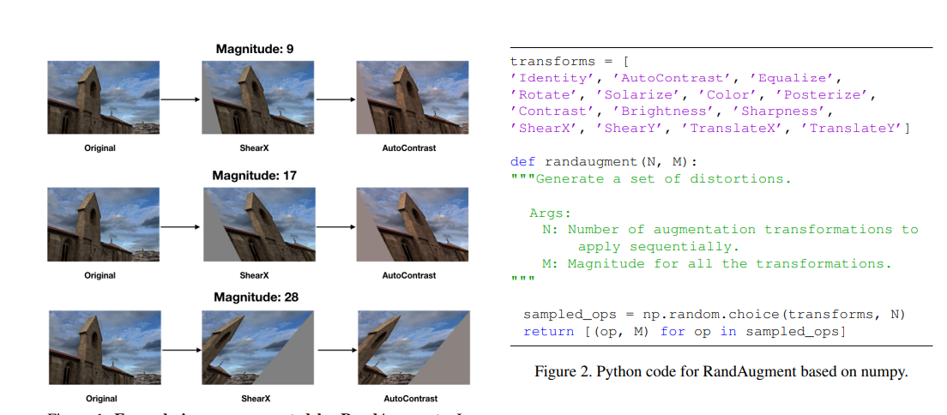
RandAugment Data Augmentation Pipeline

Slide 28
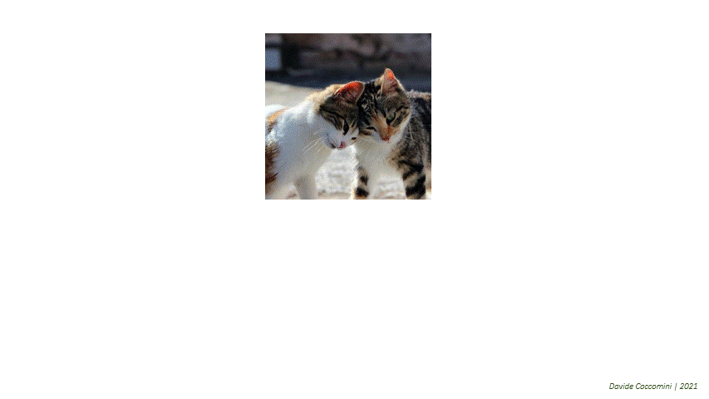
RandAugment Data Augmentation Pipeline
Multi-Crops [Global & Local ] ➔ RandAugment
RandAugment
Image source

Slide 29
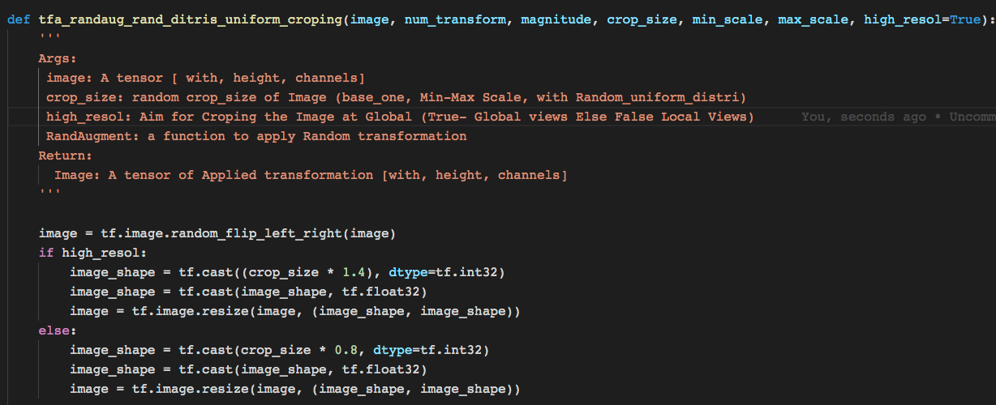
Global/Local Views + RandAugment -- Augmentation

Slide 30
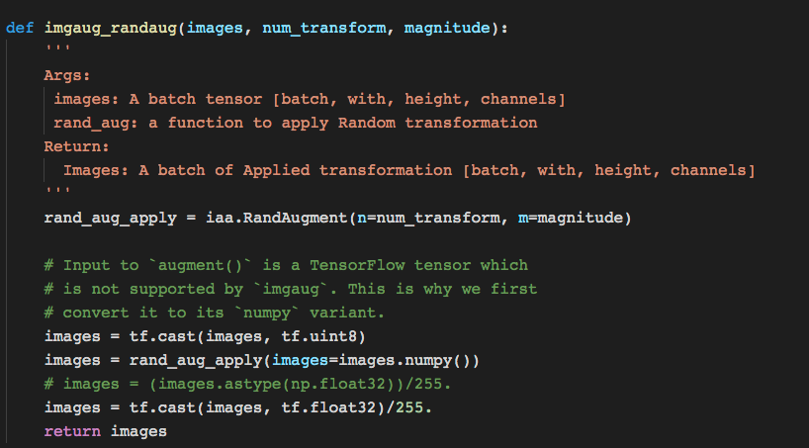
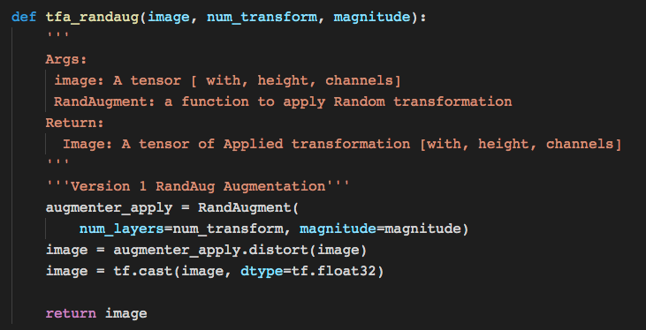
RandAugment – (Images-Batches) Implementation
Apply for Single Image
Apply for Mini Batch Image

Slide 31
RandAugment – (Images-Batches) Implementation
Apply for Single Image
Apply for Mini Batch Image

Slide 32
Demonstration Building AutoAugment Pipeline

Slide 33
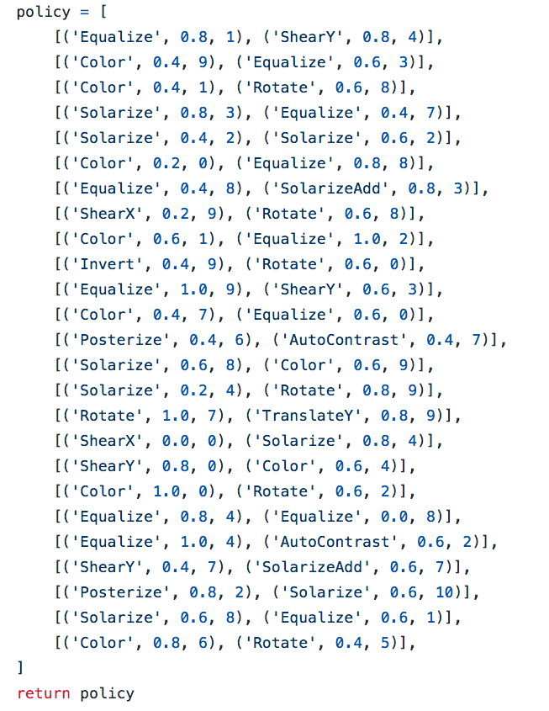
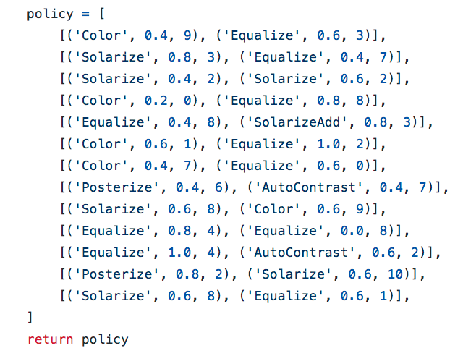
Auto-Augmentation -- Augmentation

Slide 34
RandAugment Data Augmentation Pipeline
Multi-Crops [Global & Local ] ➔ RandAugment
RandAugment
Image source

Slide 35
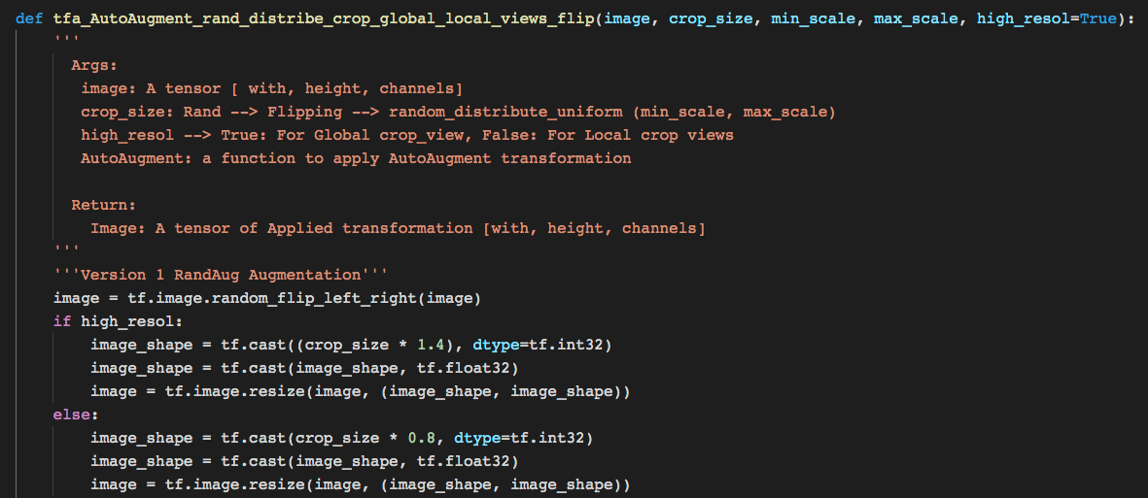
Global/Local Views – Auto-Augmentation

Slide 36
Global/Local Views – Auto-Augmentation

Slide 37
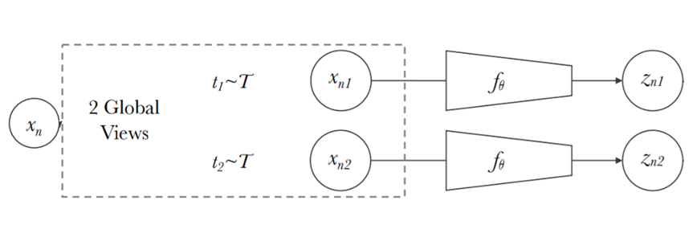
Building the train multi-Augmentation Strategies (Two-Views and Multi-Views)
RandAugment , AutoAugment , FastAuto Augmentation

Slide 38
How to Implement in Multi-Views ?

Slide 39
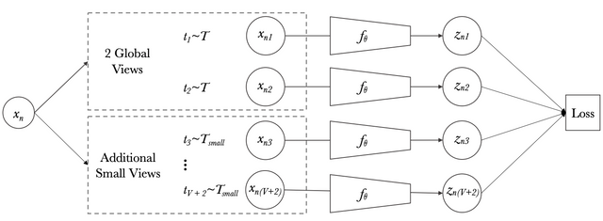
Consideration Multi-Views Augmentation
Input Data → Different sizes of Inputs (224 - global views 160-96-Local Views)
Training Loop → Different Design compare to two views Gradients & Losses updates

Slide 40
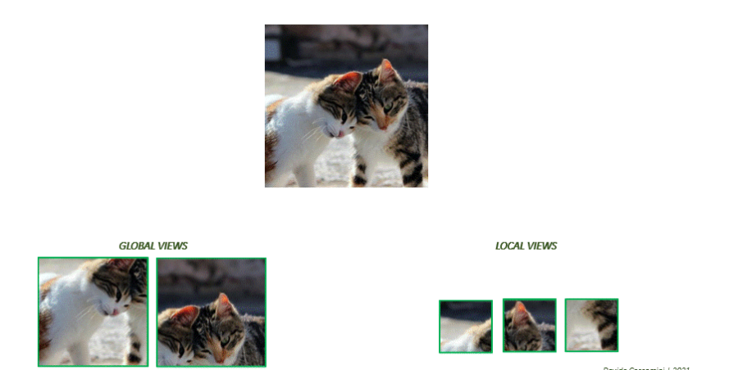
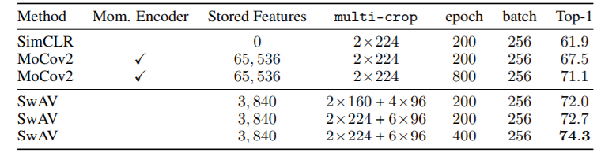
Design Multi-Views Augmentations

Slide 41
Design Multi-Views Augmentations
224 → 2x Global Views
96 or 160 → 6x Global Views

Slide 42
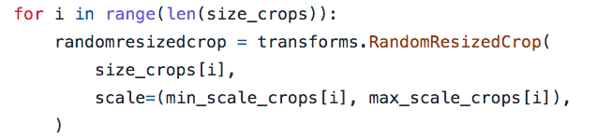
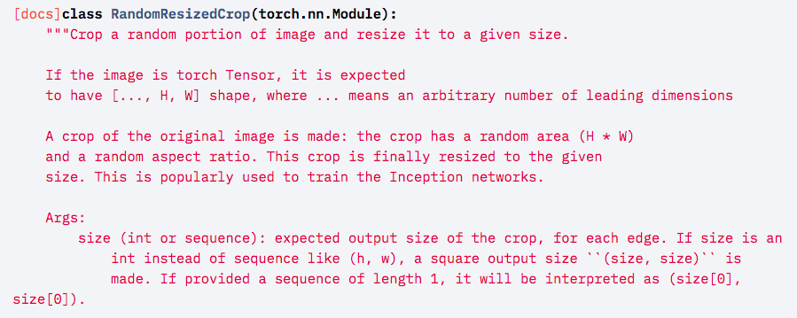
Design Multi-Views Augmentations
SIZE_CROPS = [224, 96]
NUM_CROPS = [2,6]

Slide 43
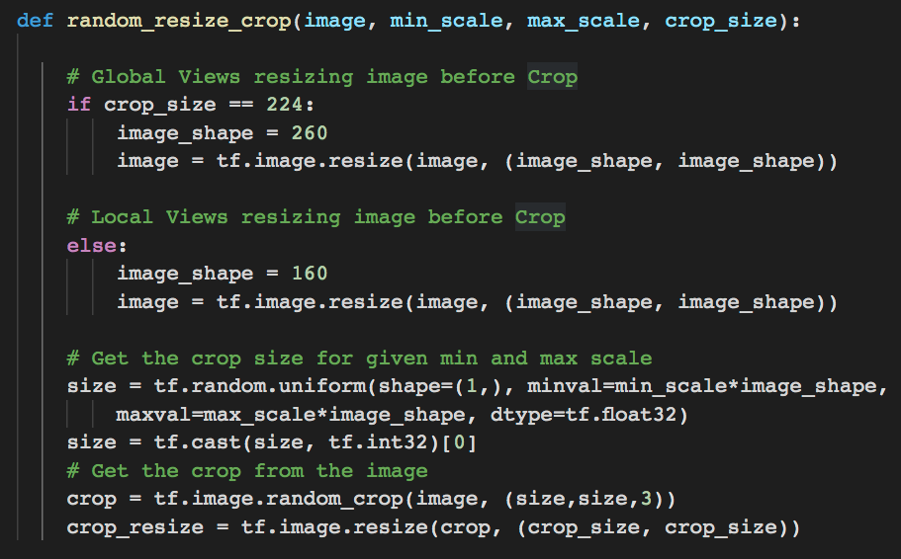
Design Multi-Views Augmentations
SIZE_CROPS = [224, 96]
NUM_CROPS = [2,6]
min_scale = [0.5, 0.14]
max_scale = [1., 0.5]
tf.random.uniform → to get Random Crop with (Min-Max scale)

Slide 44
Design Multi-Views Augmentations
SIZE_CROPS = [224, 96]
NUM_CROPS = [2,6]
min_scale = [0.5, 0.14]
max_scale = [1., 0.5]
tf.random.uniform → to get Random Crop with (Min-Max scale)

Slide 45
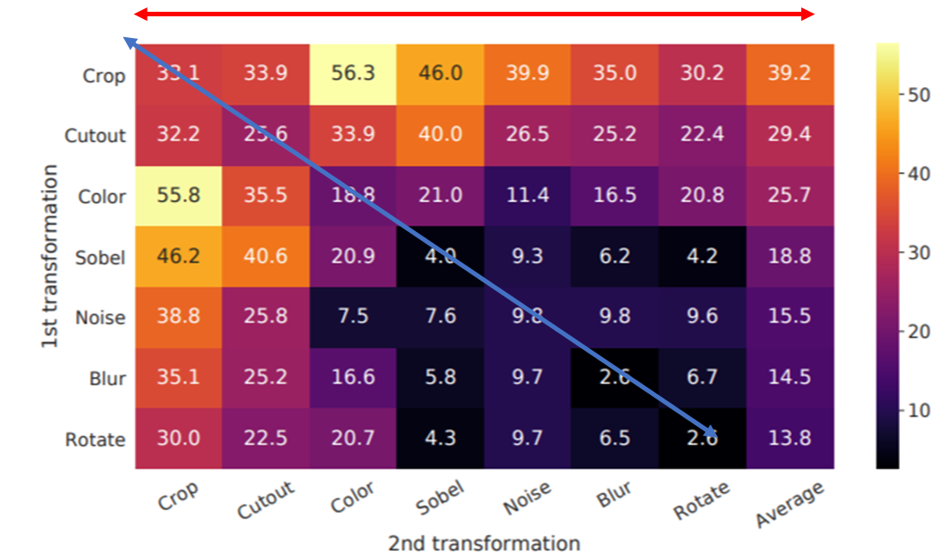
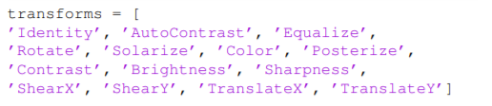
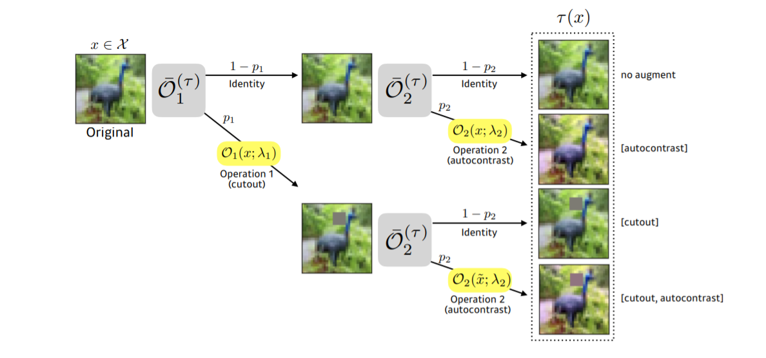
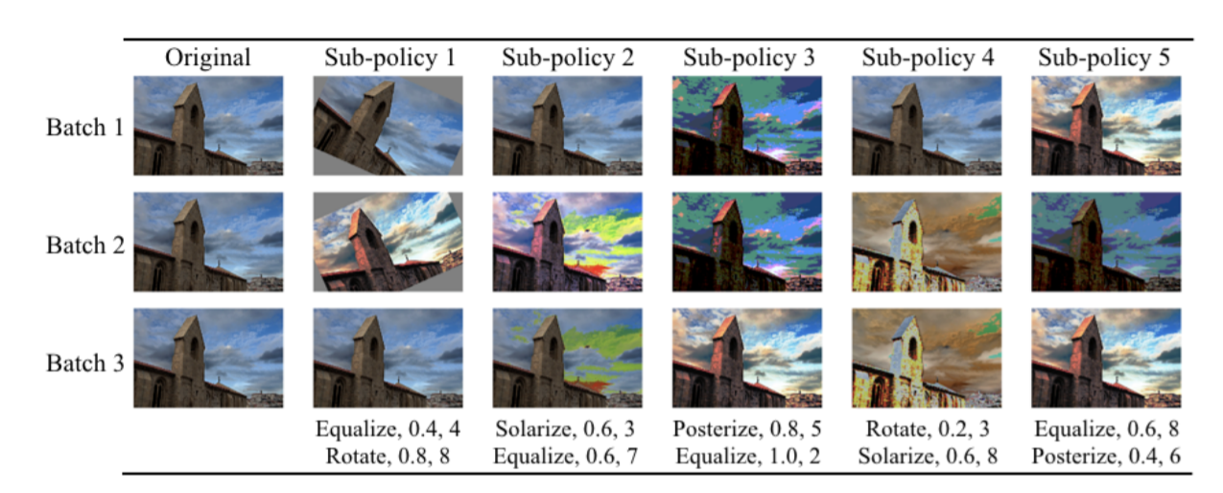
Get Multi-Crops => Augmentation Strategies
Baseline Handcrafted Defined Strategy
Random Search
Policy Bayesian optimization Search
Policy Strategy Auto Augmentation

Slide 46
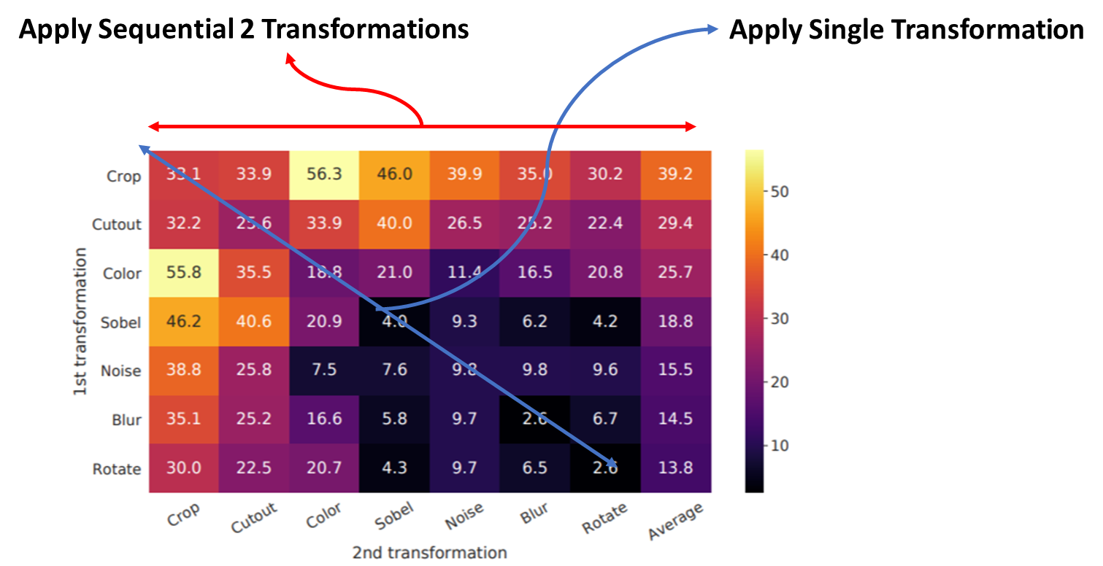
Defined Strategy Implementation
Data-Augmentation

Slide 47
Implementation Other
Data-Augmentation Strategies Consider affine Transformation and Rotation Transofrmation → Binary Masks

Slide 48
Part 3 Building Neural Net Architecture
What are neural net architectures suitable ?
How to build the Neural Net architectures ?

Slide 49
Part 4 Building Self-Supervised Training Framework
How many frameworks of Self-Supervised ?
How to build self-Supervised Frameworks ?

Slide 50
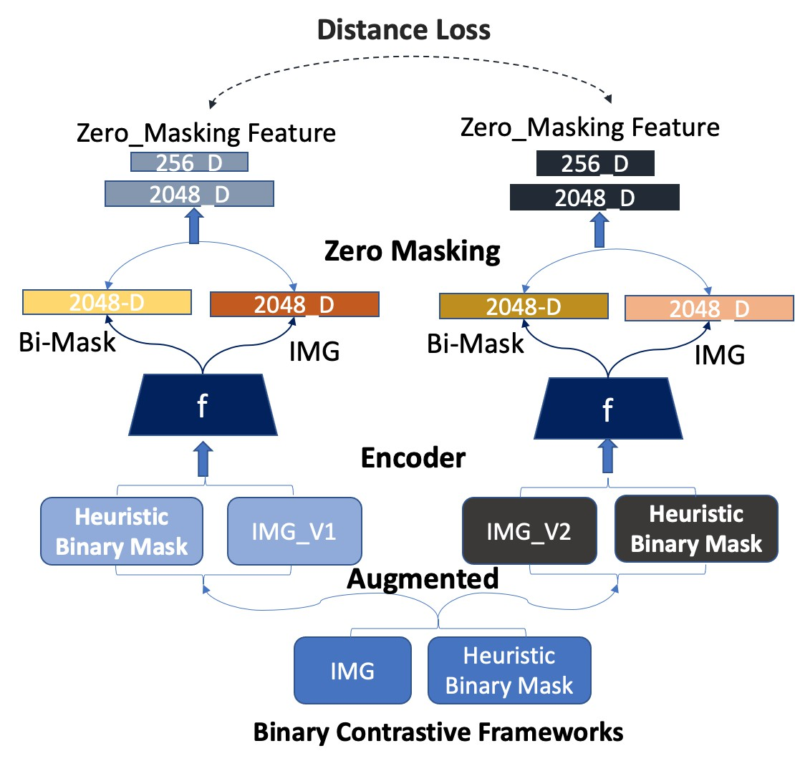
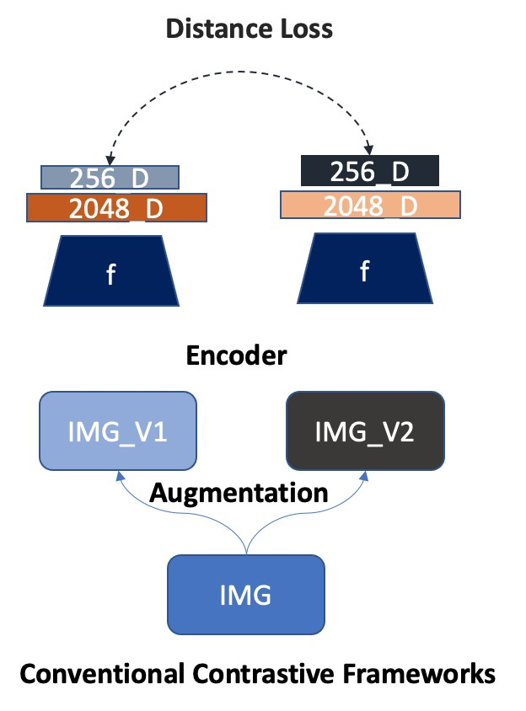
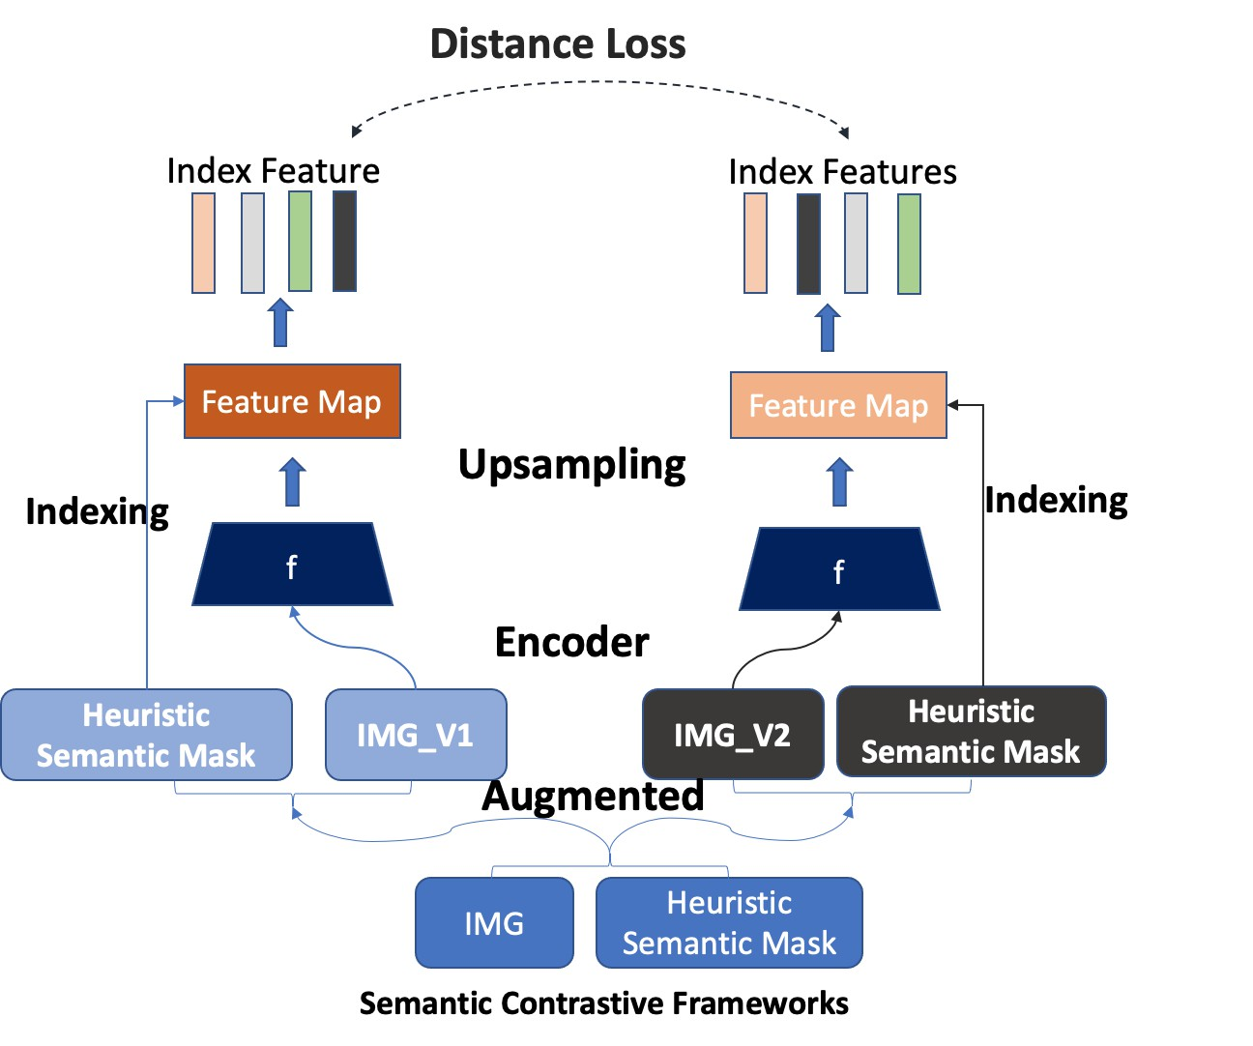
Heuristic Attention Represenation

Slide 51
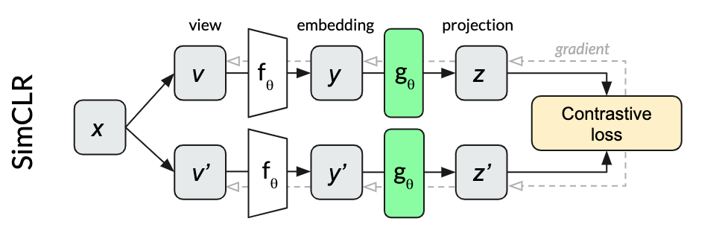
Conventional Contrastive Self-Supervised Framework

Slide 52
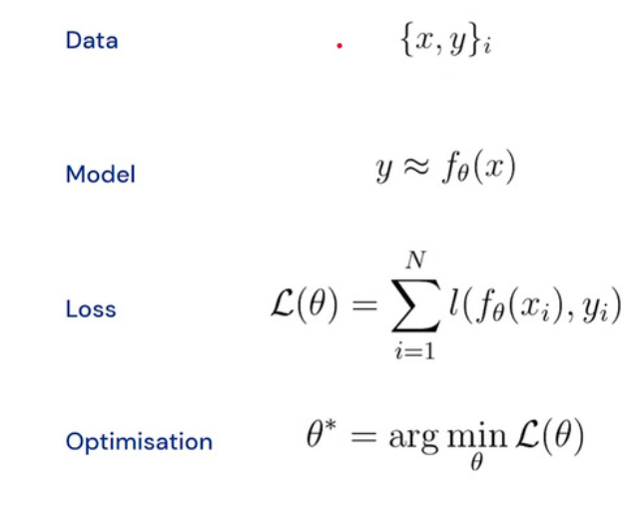
Supervised Learning Objective

Slide 53
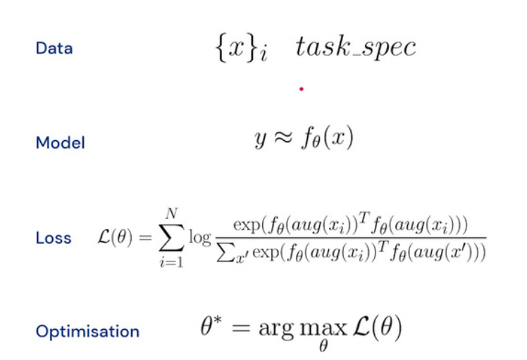
Self-Supervised Learning Objectives

Slide 54
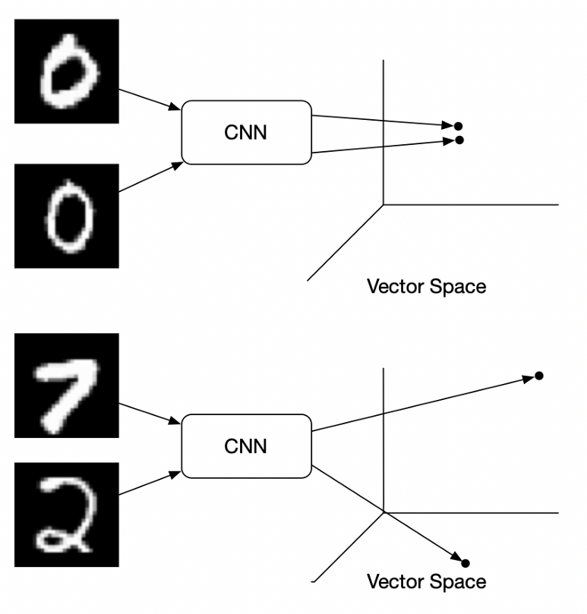

Self-Supervised Contrastive Methods– Contrastive-LOSS
Max margin contrastive loss (Hadsell et al. 2006)
Triplet loss (Weinberger et al. 2006)
easy: triplets with a loss of 0 because the negative is already more than a margin away from the anchor than the positive
hard: triplets where the negative is closer to the anchor than the positive
semi-hard: triplets where the negative lies in the margin
Contrastive Loss

Slide 55



Self-Supervised Contrastive Methods– Contrastive-LOSS
Multi-class N-pair loss (Sohn 2016)
Triplet loss (left) and its extension (N+1)-triplet loss (right) (from Sohn 2016)
Contrastive Loss

Slide 56



Self-Supervised Contrastive Methods– Contrastive-LOSS
Self Supervised NT-Xent loss (Chen et al. 2020)
SimCLR--Paper
Supervised NT-Xent loss (Khosla et al. 2020)
Supervised Contrastive-paper
Contrastive Loss

Slide 57
Self-Supervised Contrastive Pipeline Methods
Self Supervised NT-Xent loss (Chen et al. 2020)

Slide 58

Binary-Contrastive Self-Supervised Framework
Contrastive_Loss NT-Xent loss (Chen et al. 2020) -- SimCLR--Paper
Binary_Contrastive_Loss– Our Proposal
Contrastive Loss of Images
Contrastive Loss of
Binary Mask

Slide 59
Binary-Contrastive Self-Supervised Framework
Contrastive_Loss NT-Xent loss (Chen et al. 2020) -- SimCLR--Paper
Binary_Contrastive_Loss– Our Proposal
Contrastive Loss of Images
Contrastive Loss of
Binary Mask
Total_Loss =

Slide 60

Binary-Contrastive Self-Supervised Framework
Contrastive_Loss NT-Xent loss (Chen et al. 2020) -- SimCLR--Paper
Binary_Contrastive_Loss– Our Proposal
Contrastive Loss of Images
Contrastive Loss of
Binary Mask
Contribute 50% of Total loss
Total_Loss =
$$\frac{1}{2}$$
$$+$$

Slide 61

Binary-Contrastive Self-Supervised Framework
Mask_Contrast paper

Slide 62

Semantic Contrastive Self-Supervised Framework
Semantic_Contrastive_Loss– Our Proposal
$$\log{\frac{exp⁡(\frac{Z_{I\left(f_{i}\right)}Z_{i\left(fi\right)}}{t})}{}}$$

Slide 63

Self-Supervised Contrastive Pipeline Methods
A Survey on Contrastive Self-Supervised Learning Jaiswal et.al 2021

Slide 64
Self-Supervised Contrastive Framework

Slide 65
Self-Supervised Non-Contrastive

Slide 66
Multi-Views Contrastive framework

Slide 67
Multi-View Non-Contrastive Framework

Slide 68
Contrastive Framework + Mixed Regularization

Slide 70
Part 5 Building Tracking Experiment
How you track the experiment that use everyone can visualize and Understand
Sharing results with others people

Slide 72
Part 6 Building Visualization are really Important
How you track the experiment that use everyone can visualize and Understand

Slide 74
Part 7 Building Parallel Training Pipeline

